Slide 1

Market-Segmentation

Slide 2
What does it mean to segment a market or to divide a market into segments?
Make a guess!

Slide 3

Speculating Language
It could be that …
I would guess that
It may be / might be …
I assume that …
Perhaps …
Maybe …
I‘m not sure, but ….

Slide 4
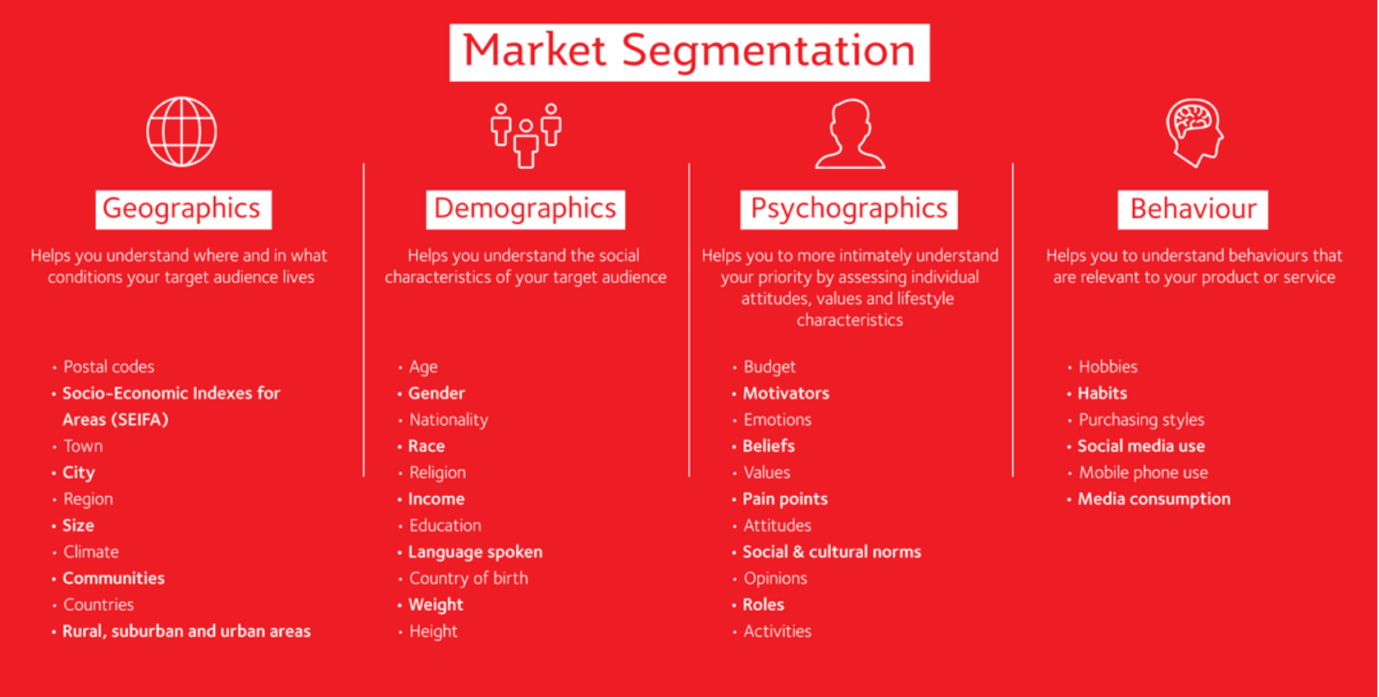
https://www.griffith.edu.au/griffith-business-school/social-marketing-griffith/segmentation

Slide 5
Task „Market Segmentation Poster“
Use the text „Market Segmentation Criteria and Approaches“. Choose one criterion and read the explanation.
Use the clilstore-link to get some support when reading the text. https://multidict.net/wordlink/?navsize=1&sl=de&url=https://multidict.net/clilstore/page.php?id=8005{and}user=Monika25
Do some vocabulary work and make a vocabulary list with new words
And now be creative! Create a powerpoint-slide (like a poster) with pictures explaining your criterion‘s idea. The challenge is to find appropriate pictures.

Slide 6

What is it?
Show your slide and let us guess which segmentation criterion your slide displays!

Slide 7
Revision
Work in pairs!
Take turns in choosing numbers and answering the question that uncover!

Slide 8


Choose a number!
"Dieses Foto" von Unbekannter Autor ist lizenziert gemäß CC BY-SA

Slide 9






Describe how a company may define a market by geographic segmentation! What are the advantages/disadvantages?

Slide 10
Describe how a company may define a market by demographic segmentation. What are the advantages/disadvantages?

Slide 11
Describe how a company may define a market by psychographic segmentation. What are the advantages/disadvantages?

Slide 12
Describe how a company may define a market by behavioural segmentation. What are the advantages/disadvantages?

Slide 13
Explain Decision-Maker-Segmentation!

Slide 14
Describe possibilities for B2B-Segmentation!

Slide 15

https://www.merriam-webster.com/words-at-play/new-scrabble-words-2018
Market Segmentation - Vocabulary (learningapps.org)

Slide 16
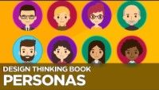
https://www.youtube.com/watch?v=W1kw5xK1C30

Slide 17

Buyer Persona
Buyer personas describe who your ideal customers are, what their days are like, the challenges they face and how they make decisions.
Buyer personas help businesses understand and empathize with their customers so they can do a better job of acquiring and serving them.

Slide 18
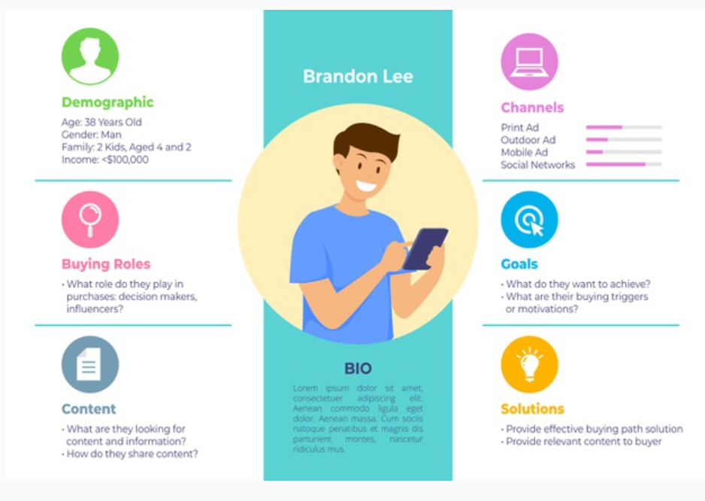

Slide 19
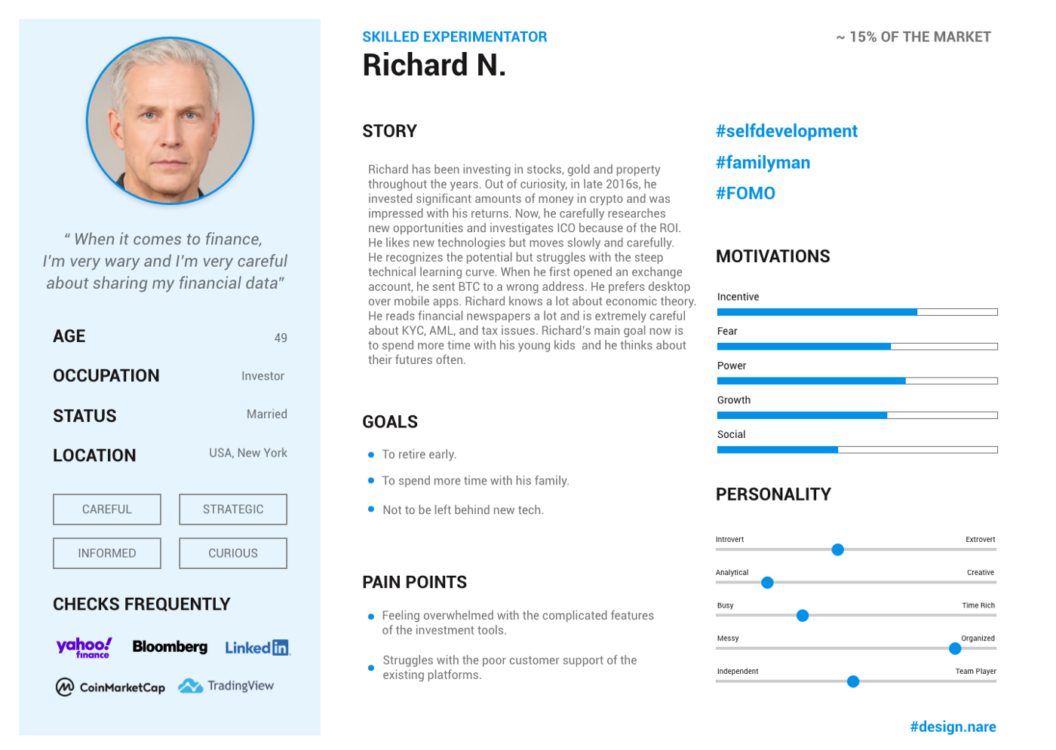

Slide 20

Let‘s assume that the hak has fk would like to use Personas to address future students and their parents!
Let‘s create a parents persona together!
https://createapersona.invisionapp.com/freehand/Create-a-persona-QEy3qm7JQ

Slide 21
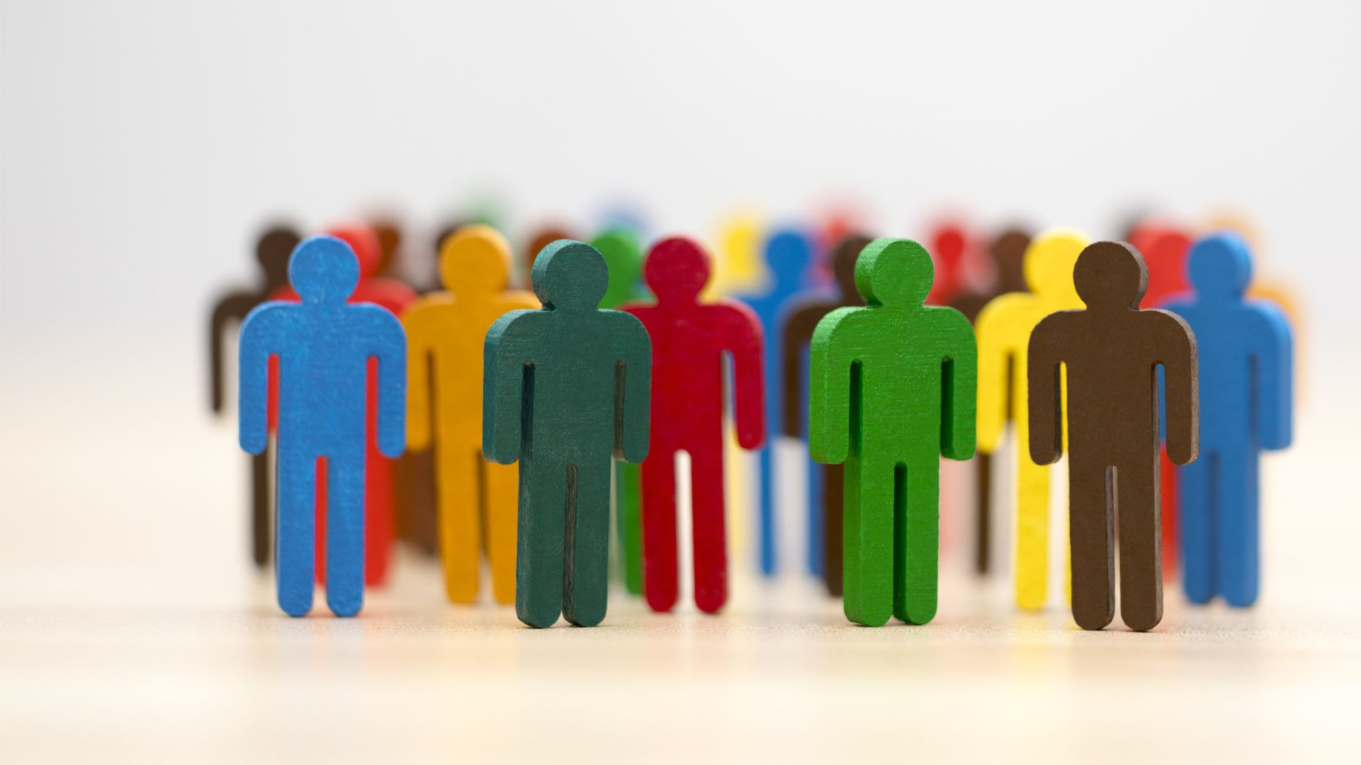
How to do it?
Get in groups of 4!
Collect information about your parents: age, profession, hobbies, concerns/worries, motivation, values, media channels they use …
Decide together if your Parent-Persona is a father or a mother, give him/her a name, and a picture, and create a fictitious parent
Present your persona to the class!

