Slide 2
Task
Write down as many brand names as you know!
You have three minutes!
Let‘s count!
Who found the most brand names!

Slide 3
www.teachingenglish.org.uk

Slide 4
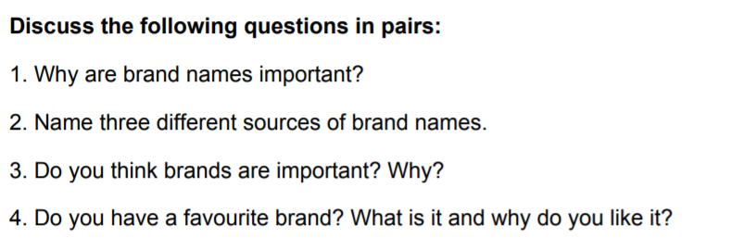

Slide 5
Can you guess where the following brand names come from?

Slide 6
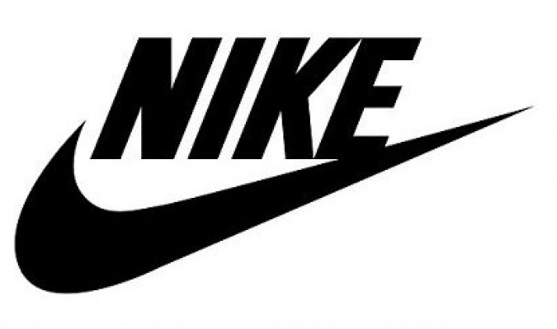
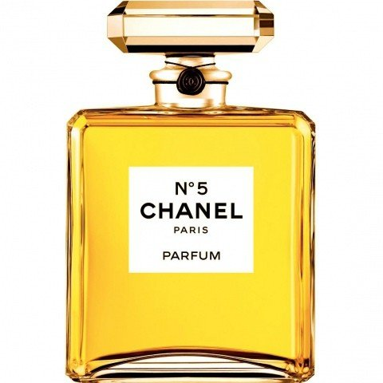
From the Latin word meaning, ‚snow-white‘.
This was the fifth perfume made by the same company.
Named after the Greek goddess of victory.
Originally a Japanese family name Toyoda. The inventors changed one letter to make it easier to pronounce overseas.
Named after an African gazelle.
The family name of two men – one a motor enthusiast and the other an engineering genius.

Slide 8
Brand name = unique name of a product that distinguishes it from other brands
01
Brand loyalty = consumers keep buying the same brand again and again
02
Brand image = image or identity given to a product which gives it a personality
03

Slide 9
Task
Create your own brand!

Slide 10
